Slide 1
Implementation of DeFT: A Deadlock-Free and Fault-Tolerant Routing Algorithm for 2.5D Chiplet Networks
Based on the DeFT algorithm by
E. Taheri, S. Pasricha & M. Nikdast
Yusuf Tahir ORHAN

Slide 2
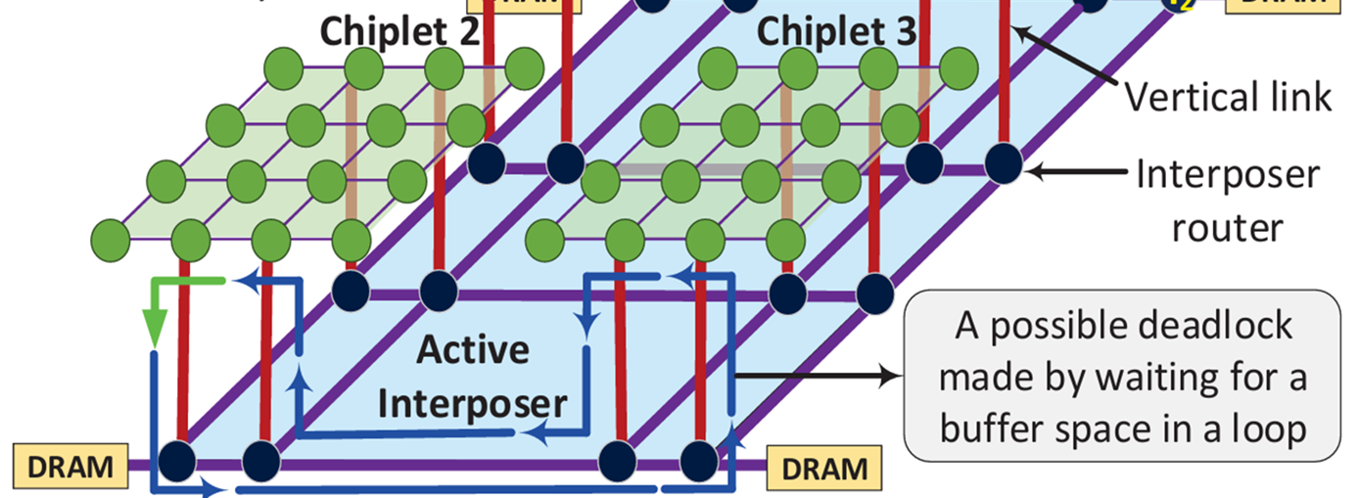
Introduction to 2.5D Integration
The Promise of 2.5D Integration: Highly scalable and cost-effective modular architecture.
Challenge 1: Deadlocks: Inter-chiplet traffic creates cyclic dependencies ("up-down-up" routing).
Challenge 2: Reliability: Vertical Links (VLs) are highly susceptible to physical failures (e.g., thermal stress, defects)
01

Slide 3
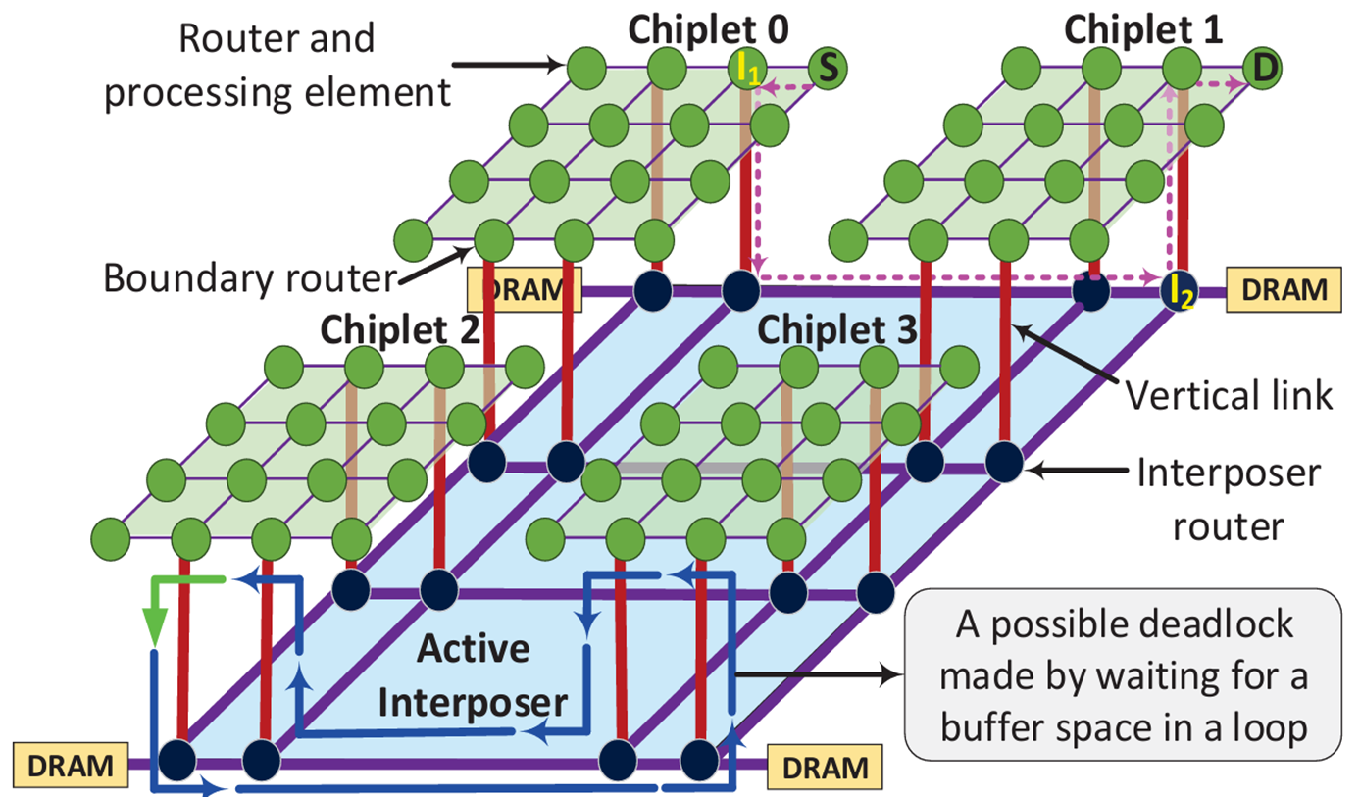
Problem Definition
System Model: 4 CPU chiplets on an active interposer. Each chiplet: 4x4 2D-mesh NoC. 4 bidirectional Vertical Links (VLs) per chiplet.
Traffic Model:
Synthetic: Uniform, Localized (40% intra-chiplet), and Hotspot.
Real-world: PARSEC benchmark traces via GEM5 full-system simulator.
Fault Model: Random permanent VL failures (manufacturing defects/thermal stress). Fault rate: 3.125% to 25% (1 to 8 faulty VLs).
Objectives:
Guarantee 100% Deadlock-freedom.
Maintain 100% Reachability under fault scenarios.
Constraints: Strictly limited to 2 Virtual Channels (VCs) per port.
02

Slide 4
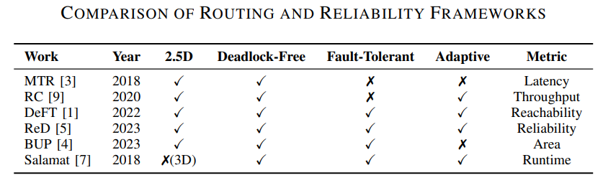
Related Work & Project Positioning
Current Solutions:
MTR (Modular Turn Restriction): Uses turn restrictions; limits VL selection.
RC (Remote Control): Requires extra buffers and permission networks; zero fault tolerance.
Project Positioning:
Status: A Replication study of the DeFT algorithm.
Purpose: Establishing a cycle-accurate hardware baseline for my Master's Thesis.
Goal: Moving towards an Extension using Reinforcement Learning optimizations.
03

Slide 5
Methodology - System Architecture & MoC
Simulation Environment: Extended Noxim (C++ based) cycle-accurate NoC simulator.
Model of Computation (MoC):
Discrete-Event Simulation (DES): For packet generation and fault injection. Synchronous
Reactive Model: For clock-driven router pipeline mechanics.
System Architecture:
Structure: 4 chiplets on an active interposer.
Dataflow: "Up-Down-Up" inter-chiplet trajectory.
Pipeline: 5-stage synchronous router pipeline (Routing, VC Allocation, SA, ST, LT).
04

Slide 6
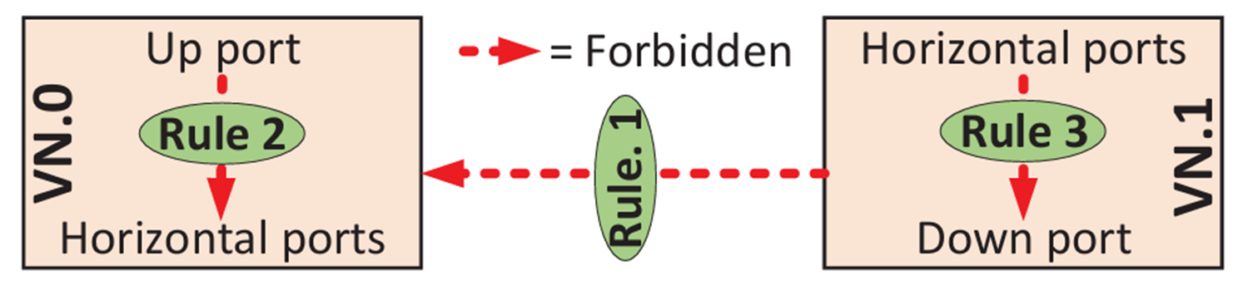
Methodology - Implementation Details
Deadlock Avoidance Logic: Implementation of 3 strict Virtual Network (VN) rules.
Rule 1: VN.1 to VN.0 is forbidden.
Rule 2: Up-to-Horizontal forbidden in VN.0.
Rule 3: Horizontal-to-Down forbidden in VN.1.
Fault Injection Manager: Centralized module to disable VL ports before simulation start.
Routing Mechanism:
Offline-generated Lookup Tables (LUTs) stored in boundary routers.
Dynamic selection of VLs based on current fault vector and congestion
05

Slide 7
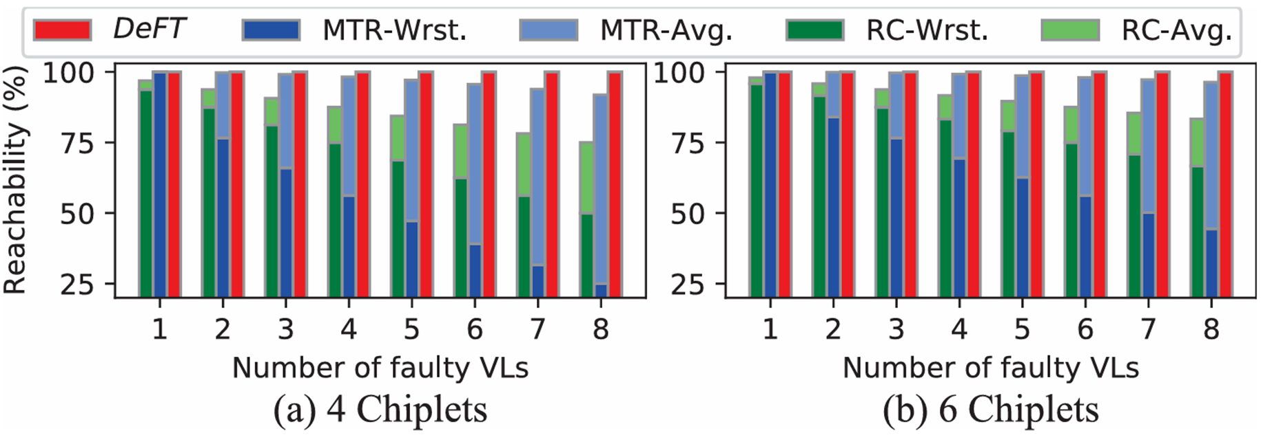
Evaluation Plan
Metrics:
Reachability (%): Ratio of delivered packets vs. injected packets.
Average Latency (cycles): End-to-end packet traversal time.
Throughput (flits/cycle/IP): Maximum data delivery rate.
Baselines for Comparison:
XY Routing (Fault-Free): Upper-bound performance baseline.
XY Routing (Fault-Injected): To demonstrate baseline failure rates
Expected Outcomes:
100% reachability under severe VL fault conditions (up to 25% fault rate).
Significant reduction in average latency compared to standard routing.
06

Slide 8
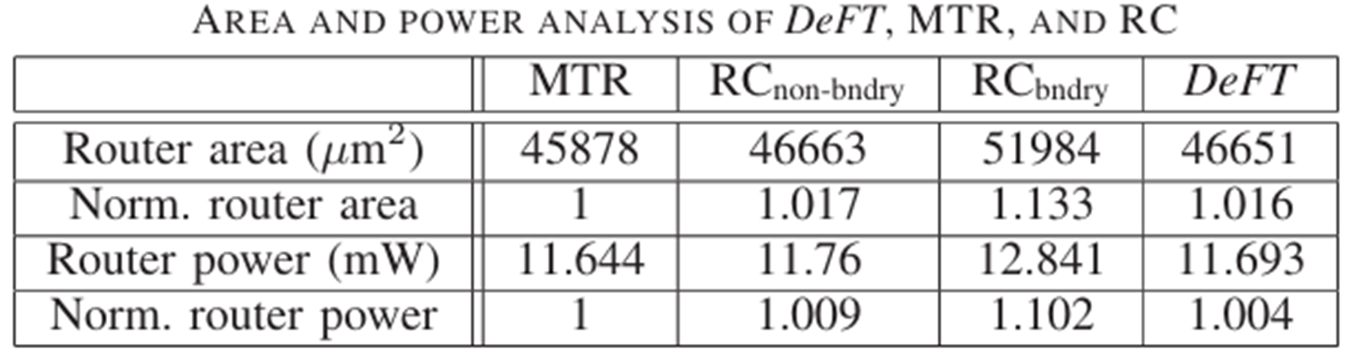
Embedded System Design (ESD) Considerations
Reliability & Safety: Strictly guaranteed deadlock-freedom via 3-rule VN logic. Fault tolerance handles permanent hardware failures.
Resource Constraints:
Virtual Channels: Limited to 2 VCs to maintain < 2% area overhead.
Buffer Depth: Fixed 4-flit depth to reflect realistic hardware limitations.
Timing Constraints: Cycle-accurate 5-stage synchronous pipeline ensures predictable timing bounds.
Scalability: Discussion on memory footprint of Lookup Tables (LUTs) with increasing chiplet counts.
07

Slide 9
Conclusion
Summary:
Implementing a robust, cycle-accurate 2.5D routing baseline.
Ensuring deadlock-freedom and fault-tolerance under severe hardware degradation.
Next Steps (Master's Thesis):
Utilizing this C++ framework to explore Reinforcement Learning-based routing optimizations.
08

